Slide 1
SWARM BASED SUDOKU SOLUTION : AN OPTIMIZATION PROCEDURE
By
SAYAK HALDAR, PRITAM KUMAR RAY, sutirtha kumar guha
RESEARCH AND APPLICATION IN ARTIFISCIAL INTELLIGENCE (RAAI - 2020)

Slide 2
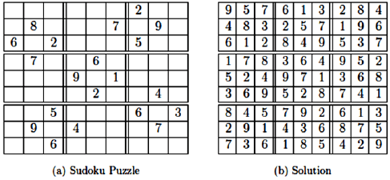
Introduction
What is Sudoku Puzzle?
Backtracking ,the traditional way to solve Sudoku.
Motivation of our concept

Slide 3
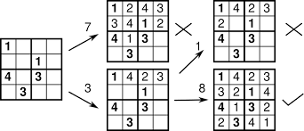
Backtracking Method to Solve Sudoku
Try for all Possible Solution
Time Complexity
Problems with Backtracking

Slide 4

Swarm Intelligence
What is Swarm Intelligence?
How does Swarm Intelligence work?
Various examples of
Swarm Intelligence

Slide 5
Proposed Work
What is ATM?
Main aspects
Objective behind ATM

Slide 6
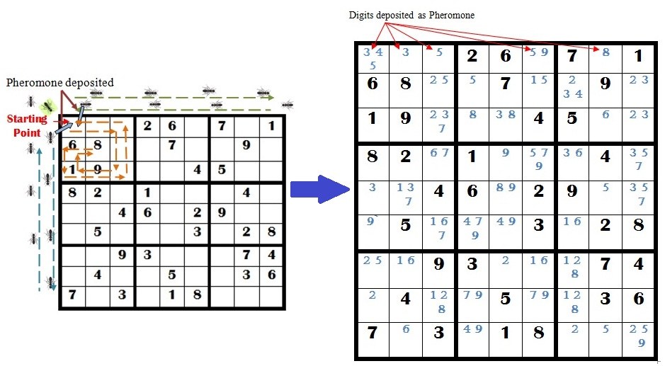
How does ATM work?

Slide 7
Advantages of ATM
In depth Feasibility study performed by Ant (agent)
Reduction of effort
Minimum number of changes

Slide 8
Performance Evaluation Parameters
Time required to produce the Output
Number of changes done in a particular
Blank Cell
Difference of Time Complexity in case of Easy, Medium and Hard Problems

Slide 9
EXPERIMENTS AND ANALYSIS
Two types of sudoku problems based on the hardness are considered. The results are summarized and compared in the following table.
|V| | Hardness | ATM |  | Backtracking
 |  | T | Time | T | Time
28 | Medium | 504 | 0.008 | 1482 | 0.008
29 |  | 1939 | 0.008 | 1939 | 0.008
29 |  | 1985 | 0.012 | 1985 | 0.008
29 |  | 583 | 0.006 | 796 | 0.007
30 |  | 0 | 0.006 | 713 | 0.007
22 | Hard | 137212 | 0.085 | 138156 | 0.085
23 |  | 1202 | 0.004 | 3207 | 0.010
24 |  | 575 | 0.007 | 79609 | 0.061
25 |  | 529 | 0.008 | 882 | 0.008
 |  | 11603 | 0.015 | 13418 | 0.016
26 |  | 11603 | 0.015 | 13418 | 0.016

Slide 10
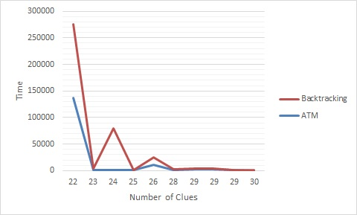
Experiment and Analysis(Contd.)
Comparison of number of times value of a cell is changed

Slide 11
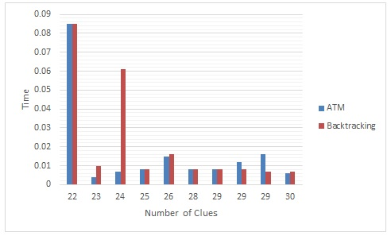
Experiment and Analysis(Contd.)
Comparative analysis of execution time between ATM and Backtracking method

Slide 12
CONCLUSION
Less Time Consumption
Number of failed attempts to insert a digit is Less
Out-performs existing algorithms
Beneficiary for solving different computational problems

Slide 13


